Slide 1


IntelliSudoku
Comparative Analysis of AI Search Algorithms for Sudoku Solving
Team Members Kazi Dider Sayed Mosfiquer Rahman KM Labib
Ahnaf Shahriar
Date
September 12, 2026

Slide 2


Problem Statement and Motivation
Sudoku is a constraint-based puzzle that demands extensive search for hard instances
Algorithm choice and heuristics strongly influence solving efficiency
Our goal is to evaluate how heuristics and constraint propagation enhance performance
Focus on puzzles with minimal clues where the challenge is greatest

Slide 3



Dataset Overview
_{1,000(4×250)} Sudoku puzzles from Kaggle's “1 Million Sudoku Games” and public 17-clue minimal puzzles
Difficulty levels: Easy, Medium, Hard, Expert based on clues and source ratings
Each puzzle includes grid, difficulty label, verified solution, and empty cell count
The same puzzles are used for all algorithms to ensure fair comparison

Slide 4



AI Search Algorithms Implemented
0
1
0
Basic Backtracking
baseline solver exploring possibilities exhaustively
Backtracking + MRV
selects cell with fewer possible values to reduce branching
0
Backtracking + Forward Checking
prunes invalid future paths early
2
3
0
4
0
5
MRV + Forward Checking
combines both heuristics for efficiency
AC-3 ConstraintPropagation
enforces arc-consistency to prune domains before/during search

Slide 5

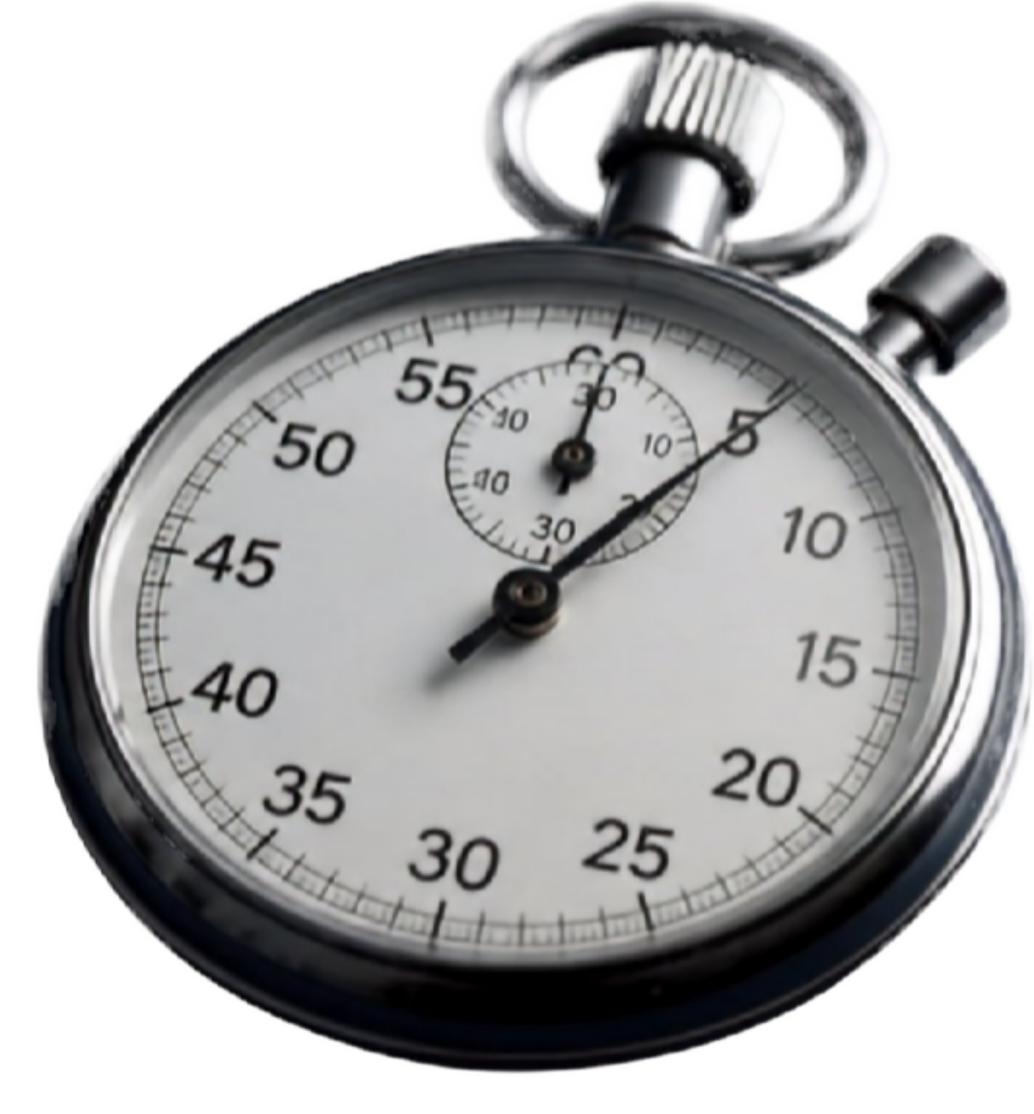
Evaluation Metrics and
Performance Measurement
Solving time
Search nodes explored
Number of backtracks
Success rate
Measured consistently across all difficulty levels and algorithms

Slide 6




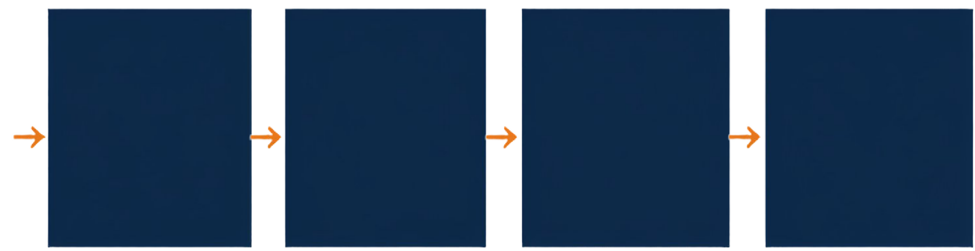
System Architecture and Workflow
A modular pipeline that solves, analyzes, and compares Sudoku puzzles with AI search algorithms
4
1
2 3
Performance Analysis
5
Input
AI Solver
Solution
Comparison
Logs metrics and statistics
Sudoku puzzle from dataset or user
Runs the selected algorithm on the puzzle
Outputs the solved puzzle grid
Visualizes and compares results across algorithms

Slide 7


Expected Outcomes
and Closing
Multiple AI Sudoku solvers including AC-3 Cleaned and labeled Sudoku dataset Performance comparison with tables and graphs Interactive Sudoku-solving demonstration system Final technical report and source code repository
^{INTELL}ISUDOKU
Thank you. Questions?

